Slide 1
Lecture 28 Oct 2021

Slide 2
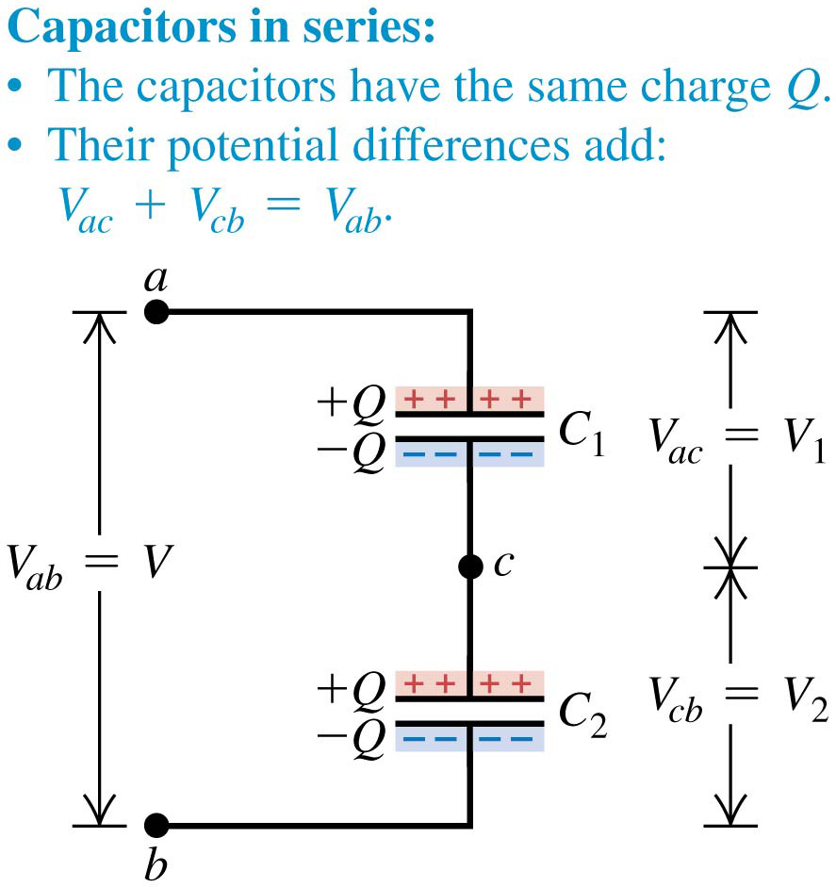
Capacitors in series: Slide 1 of 3
Capacitors are in series if they are connected one after the other, as illustrated.
The equivalent single capacitor is shown on the next slide.

Slide 3
Capacitors in series
The top plate of C₁ acquires a positive charge Q. The electric field of this positive charge pulls negative charge up to the bottom plate of C₁ until all of the field lines that begin on the top plate end on the bottom plate. This requires that the bottom plate have charge -Q.
These negative charges had to come from the top plate of C₂ , which becomes positively charged with charge +Q. This positive charge then pulls negative charge -Q from the connection at point b onto the bottom plate of C₂ .
The total charge on the lower plate of C₁ and the upper plate of C₂ together must always be zero because these plates aren’t connected to anything except each other. Thus in a series connection the magnitude of charge on all plates is the same.

Slide 4
Capacitors in series

Slide 5
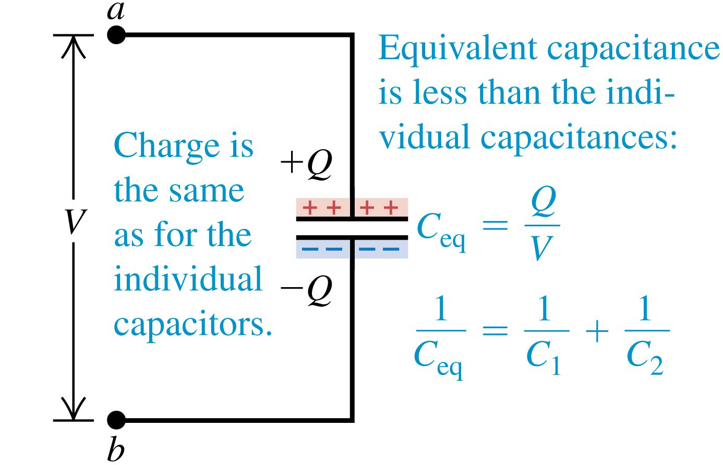
Capacitors in series: Slide 2 of 3

Slide 6
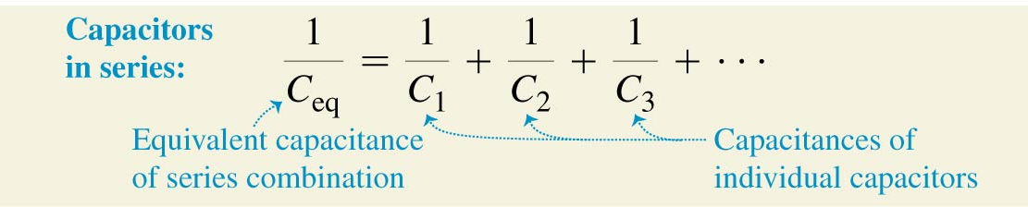
Capacitors in series: Slide 3 of 3
When several capacitors are connected in series, the magnitude of charge is the same on all plates of all the capacitors.
The potential differences of the individual capacitors add to give the total potential difference across the series combination: V_{total} = V₁ + V₂ + V₃ + ∙ ∙ ∙
The equivalent capacitance of the series combination is given by:

Slide 7
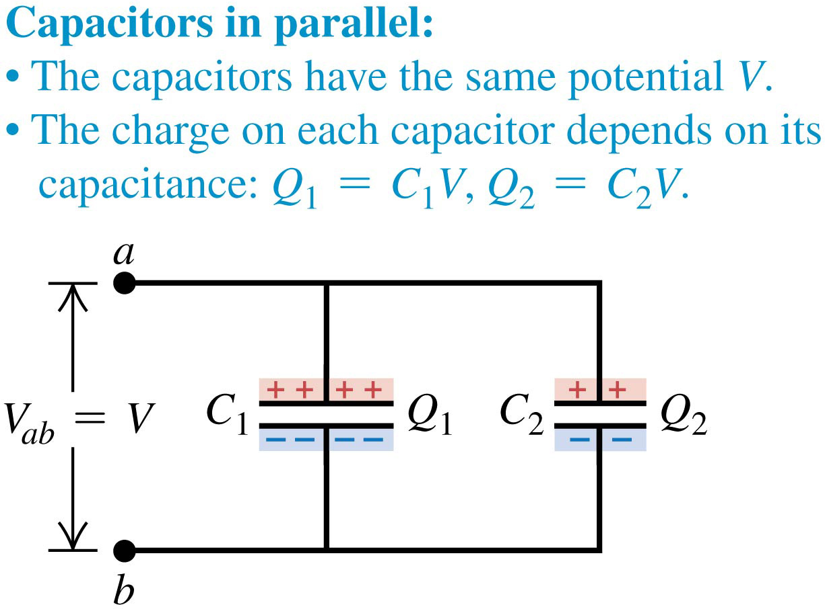
Capacitors in parallel: Slide 1 of 3
Capacitors are connected in parallel between a and b if the potential difference V_{ab} is the same for all the capacitors.

Slide 8
Capacitors in parallel
The charges Q₁ and Q₂ are not necessarily equal, however, since charges can reach each capacitor independently from the source (such as a battery) of the voltage V_{ab} . The charges are
Q₁ = C₁V and Q₂ = C₂V
The total charge Q of the combination, and thus the total charge on the equivalent capacitor, is
Q = Q₁ + Q₂ = (C₁ + C₂)V
Q/V = C₁ + C₂

Slide 9
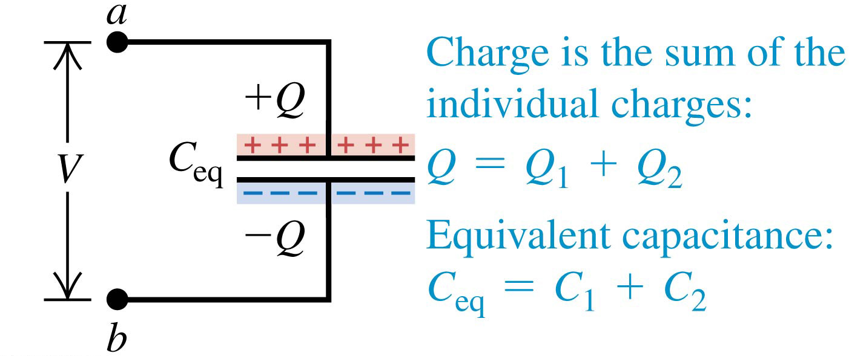
Capacitors in parallel: Slide 2 of 3
This is the equivalent capacitor of two capacitors connected in parallel.

Slide 10
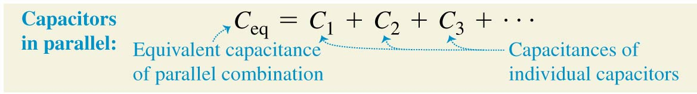
Capacitors in parallel: Slide 3 of 3
When several capacitors are connected in parallel, the potential differences are the same for all the capacitors.
The charges on the individual capacitors add to give the total charge on the parallel combination:
Q_{total} = Q₁ + Q₂ + Q₃ + ∙ ∙ ∙
The equivalent capacitance of the parallel combination is given by:

Slide 13
Find the equivalent capacitance of the five-capacitor network shown in Fig. 24.10a.

Slide 14
Energy stored in a capacitor
The electric potential energy stored in a charged capacitor is just equal to the amount of work required to charge it—that is, to separate opposite charges and place them on different conductors.
When the capacitor is discharged, this stored energy is recovered as work done by electrical forces.

Slide 15
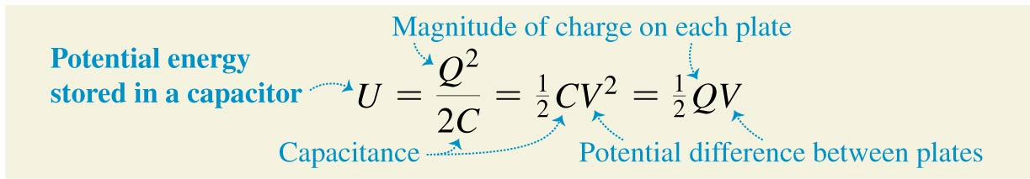
Energy stored in a capacitor
The potential energy stored in a capacitor is:
where Q = CV.

Slide 16

Energy stored in a capacitor
We can charge a capacitor by moving electrons directly from one plate to another.
This requires doing work against the electric field between the plates.
Thus we can think of the energy as being stored in the field in the region between the plates.
The energy density is:

Slide 17
We connect a capacitor C₁ = 8.0 μF to a power supply, charge it to a potential difference V₀ = 120 V, and disconnect the power supply (Fig. 24.12). Switch S is open. (a) What is the charge Q₀ on C₁? (b) What is the energy stored in C₁? (c) Capacitor C₂ = 4.0 μF is initially uncharged. We close switch S. After charge no longer flows, what is the potential difference across each capacitor, and what is the charge on each capacitor? (d) What is the final energy of the system?
(a) The initial charge Q₀ on C₁ is
(b) The energy initially stored in C₁ is

Slide 18
Conservation of charge requires that Q₁ + Q₂ = Q₀. The potential difference V between the plates is the same for both capacitors because they are connected in parallel, so the charges are Q₁ = C₁V and Q₂ = C₂V.
Q₁ + Q₂ = Q₀
Q₁ = C₁V
Q₂ = C₂V
C₁V + C₂V = (C₁ + C2)V = Q₀

Slide 19
(d) The final energy of the system is
The final energy is less than the initial energy; the difference was converted to energy of some other form. The conductors become a little warmer because of their resistance, and some energy is radiated as electromagnetic waves.

Slide 20
(a) What is the magnitude of the electric field required to store
1.00 J of electric potential energy in a volume of 1.00 m³ in vacuum? (b) If the field magnitude is 10 times larger than that, how much energy is stored per cubic meter?
(b) Equation (24.11) shows that u is proportional to E². If E
increases by a factor of 10, u increases by a factor of 10² = 100,
so the energy density becomes u = 100 J/m3.

Slide 21
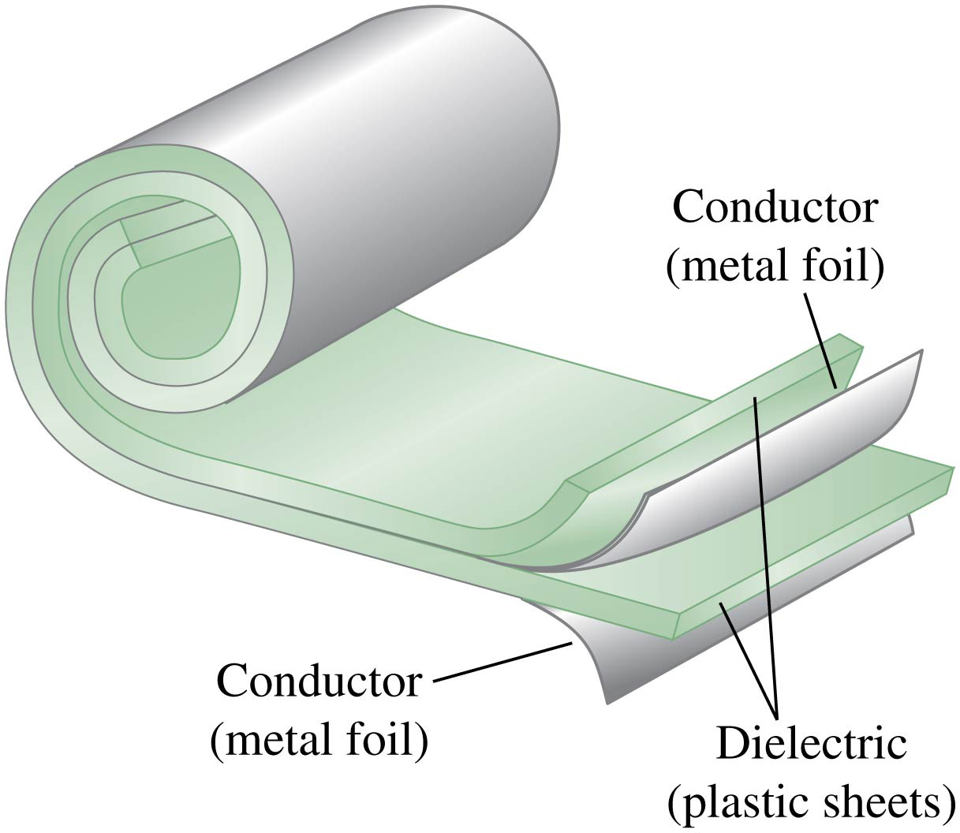
Dielectrics
Most capacitors have a nonconducting material, or dielectric, between their conducting plates.
A common type of capacitor uses long strips of metal foil for the plates, separated by strips of plastic sheet such as Mylar.

Slide 22
Dielectrics
Placing a solid dielectric between the plates of a capacitor serves three functions.
First, it solves the mechanical problem of maintaining two large metal sheets at a very small separation without actual contact.
Second, using a dielectric increases the maximum possible potential difference between the capacitor plates.
Third, the capacitance of a capacitor of given dimensions is greater when there is a dielectric material between the plates than when there is vacuum.

Slide 23
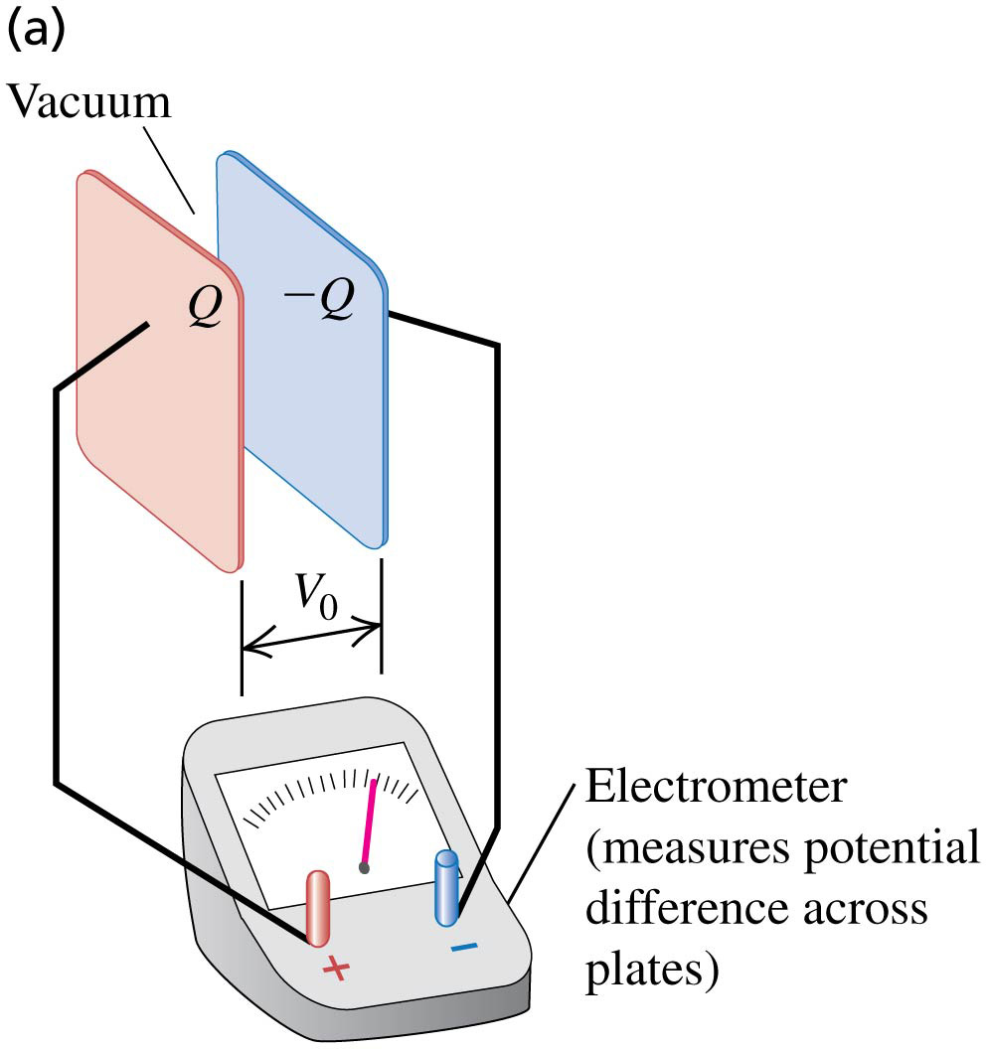
Dielectrics increase capacitance: Slide 1 of 2
Consider an electrometer connected across a charged capacitor, with magnitude of charge Q on each plate and potential difference V₀.

Slide 24
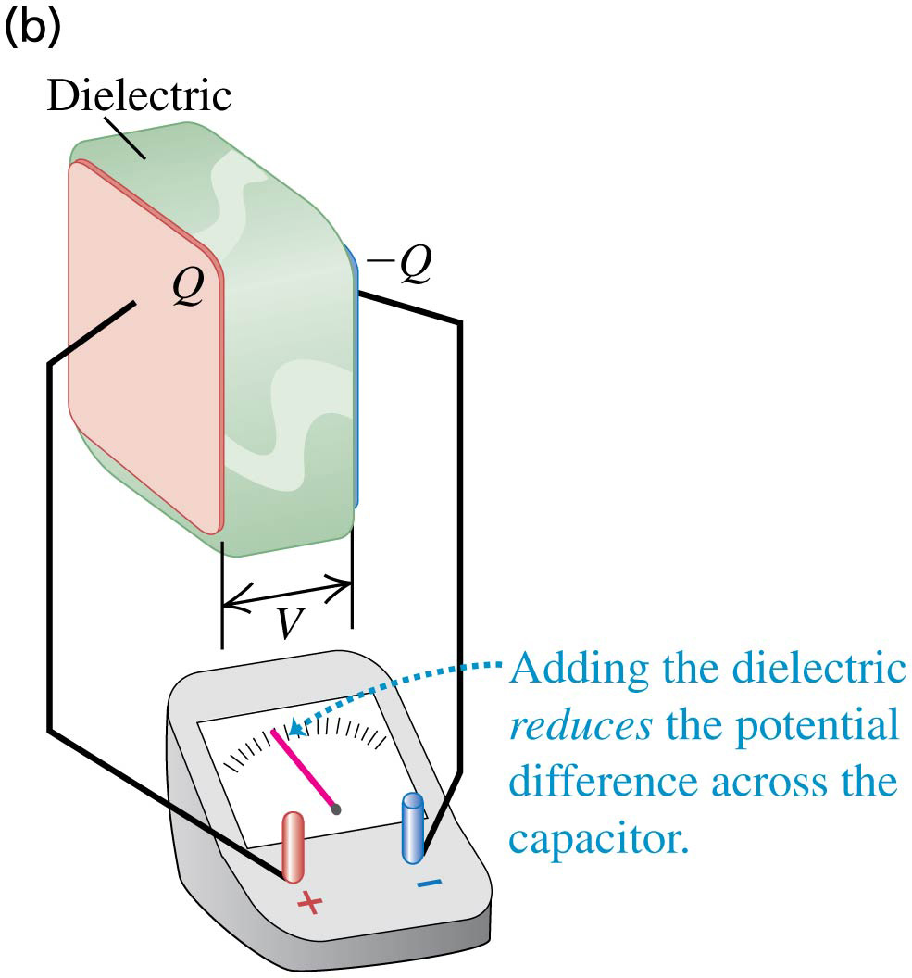
Dielectrics increase capacitance: Slide 2 of 2
When we insert an uncharged sheet of dielectric, such as glass, paraffin, or polystyrene, between the plates, the potential difference decreases to a smaller value V.
Since Q is unchanged, the capacitance C = Q/V is increased with the dielectric.

Slide 25
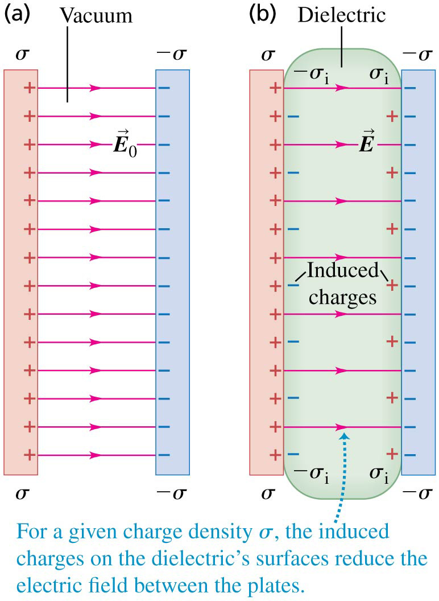
Dielectrics
When a dielectric is inserted between the plates of a capacitor, the electric field decreases.
This is due to polarization of the charge within the dielectric, which results in induced surface charges, as shown.

Slide 26
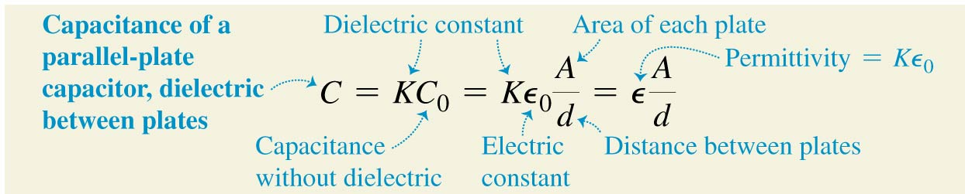
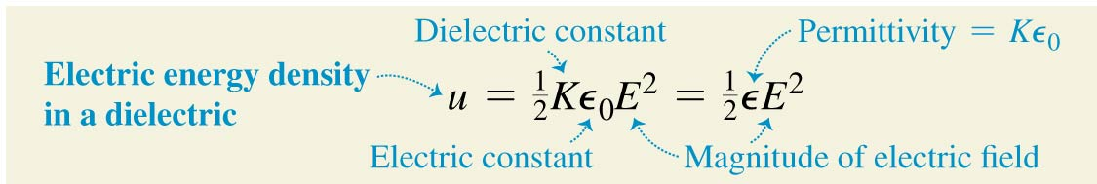
The dielectric constant
When an insulating material is inserted between the plates of a capacitor whose original capacitance is C₀, the new capacitance is greater by a factor K, where K is the dielectric constant of the material.
The energy density in the capacitor also increases:

Slide 27
Table 24.1—Some dielectric constants
Material | K
Vacuum | 1
Air (1 atm) | 1.00059
Teflon | 2.1
Mylar | 3.1
Glass | 5 – 10
Glycerin | 42.5
Water | 80.4

Slide 29
Find (a) the original capacitance C₀;
(b) the magnitude of charge Q on each plate;
(c) The capacitance C after the dielectric is inserted;
When the dielectric is inserted, Q is unchanged but the potential
difference decreases to V = 1.00 kV.

Slide 30
(d) the dielectric constant K of the dielectric;
(e) the permittivity ε of the dielectric;

Slide 31
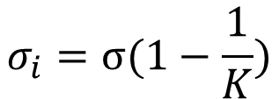
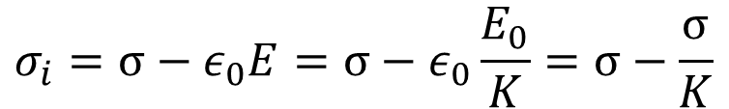
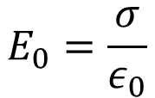
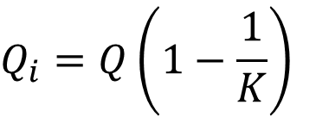
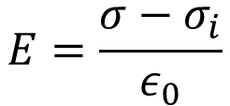
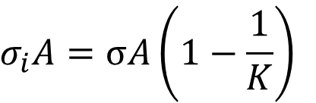
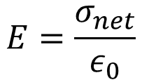
(f) the magnitude of the induced charge Q_{i} on each face of the
dielectric;
$$σ_{i}=σ−ε_{0}E=σ−ε_{0}\frac{E_{0}}{K}=σ−\frac{σ}{K}$$
$$E_{0}=\frac{σ}{ε_{0}}$$
$$σ_{i}=σ(1−\frac{1}{K})$$
$$σ_{i}A=σA\left(1−\frac{1}{K}\right)$$
$$Q_{i}=Q\left(1−\frac{1}{K}\right)$$
$$E=\frac{σ_{net}}{ε_{0}}$$
$$E=\frac{σ−σ_{i}}{ε_{0}}$$

Slide 32
(g) the original electric field E₀ between the plates;
(h) the electric field E after the dielectric is inserted.
or

Slide 33
or

Slide 34
Find the energy stored in the electric field of the capacitor in Example 24.10 and the energy density, both before and after the dielectric sheet is inserted.
The stored energies U₀ and U without and with the dielectric:
The energy densities without and with the dielectric:

Slide 35
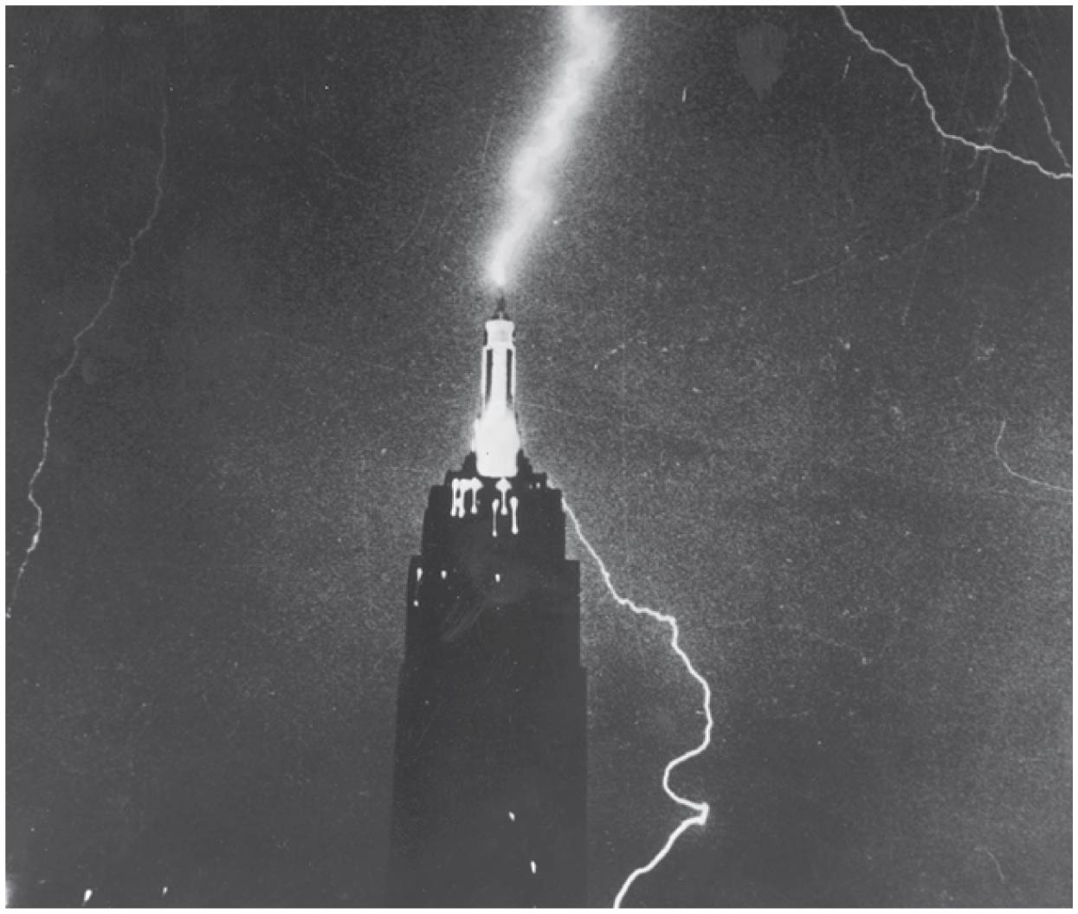
Dielectric breakdown
If the electric field is strong enough, dielectric breakdown occurs and the dielectric becomes a conductor.
The dielectric strength is the maximum electric field the material can withstand before breakdown occurs.
For example, Pyrex glass has a dielectric constant of K = 4.7, and a dielectric strength of E_{m} = 1 × 10⁷ V/m.
Dry air has a dielectric constant of K = 1.00059 and a dielectric strength of E_{m} = 3 × 10⁶ V/m.

